Slide 1
Value Iteration
CS6700-Introduction to Reinforcement Learning

Slide 2


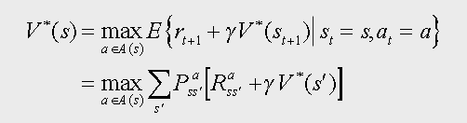
Recap
Bellman Equation:-
Bellman Optimality Equation:-

Slide 3
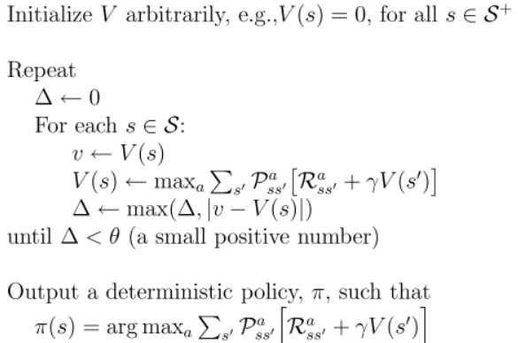
Value Iteration

Slide 4
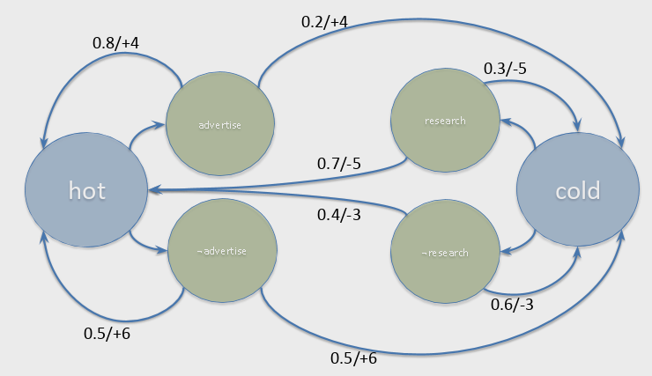
Example 1:-
The product that a computer manufacturing company sells can either be hot-selling, or selling poorly. If the product is hot-selling, the company can advertise its product to get an immediate reward of 4 units. On doing so,
with probability 0.8, the product continues to sell well. However, with probability 0.2, the product starts selling poorly. The company can alternately decide not to advertise a hot-selling product yielding an immediate reward of 6 units with a 0.5 probability that the product continues to remain hot-selling.
In case the product is selling poorly, the company has the option to perform research to improve its product. This results in an immediate reward of -5 units and a 0.7 probability of the research leading to the product becoming a hot-selling one. Finally, if the company decides not to perform research for a poorly selling product, it receives an immediate reward of -3, with the product continuing to sell poorly with a probability of 0.6.
Formulate this problem as a Markov Decision Process.

Slide 5
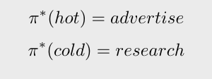
Example 1:-
Iteration 1:-
V(hot) = 6.0
V(cold) = -3.0
Iteration 2:-
V(hot) = 24.96
V(cold) = -14.97
Iteration 1000:-
V(hot) = 202.0
V(cold) = 192.0
Optimal Policy:-

Slide 6
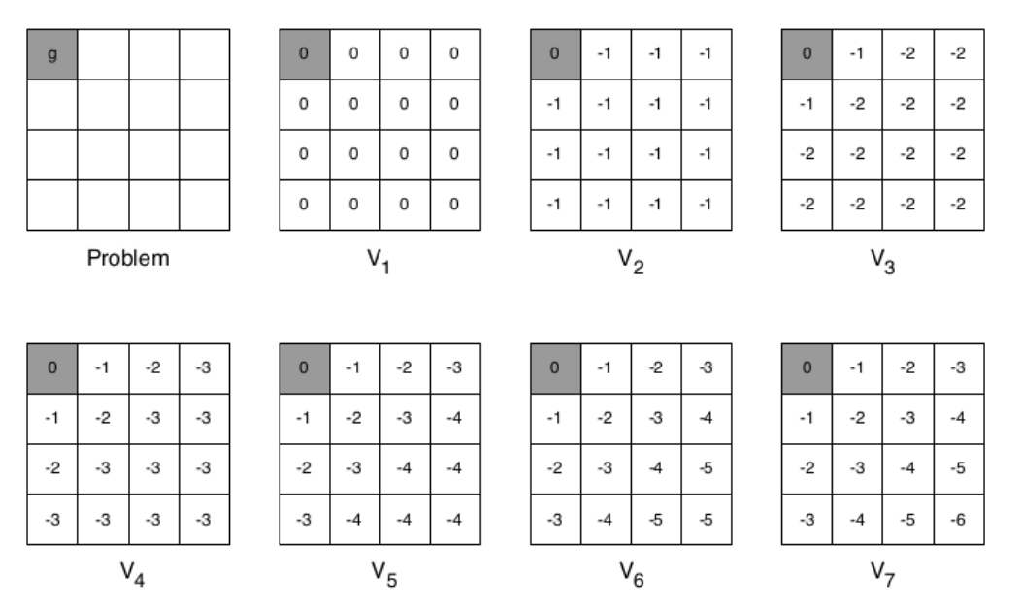
Example 2:-

Slide 7
Demo
https://cs.stanford.edu/people/karpathy/reinforcejs/gridworld_dp.html

